Slide 1
Chapter 2
The Silver Spoon

Slide 2
Word Analysis
Read page 19
a) Find and copy one word used to describe Gerard’s hands.
b) Can you find any other adjectives to describe Gerard’s hands in the chapter?
What simile is used to describe Tosher’s hair on page 23?
“The wind in the alley cut through them instantly.” What does ‘cut through them instantly’ mean?
On page 17 we read, “flues … ran up the backbone of the house like a river with many tributaries”
a) What are tributaries?
b) What image does this give you?
On page 21, we read that Gerard “adopted the writhing, fawning attitude he reserved for the clients …” What do these words mean:
a) writhing
b) fawning
On page 23 we read the word “obsequious”. What do you think this might mean?

Slide 3
Inference
On page 19 Billy does something surprising.
a) What does this tell you about Billy’s character?
b) How do the little ’uns respond, and what does this tell you about their character?
On page 20 it says, “to his way of thinking every speck was coin stolen from his purse.” What are these words telling us about Gerard?
What is the difference in the relationship between Billy and the little ‘uns, and Billy and Tosher? How can you tell there is a difference?
Why do you think Gerard’s clients say nothing about his treatment of the boys?
Where do you think the silver spoon could have come from? What does its appearance mean for Billy and Tosher?

Slide 4
Activity 1: Money
In Victorian times, money was in pounds, shillings and pence. There were:
  12 pence in 1 shilling
  20 shillings in 1 pound
But there were many more coins - which made things very confusing! Can you fill out the table on your sheets? You’ll need to remember your fractions! Work with a partner or in groups.

Slide 5
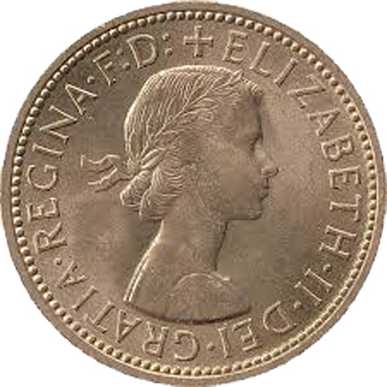
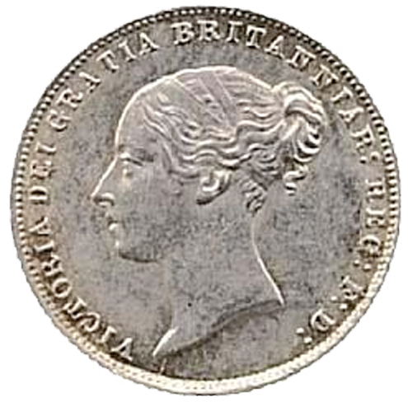
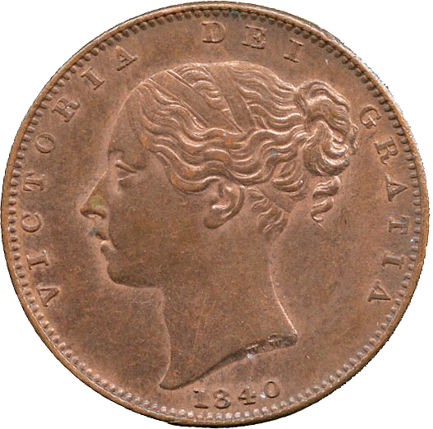
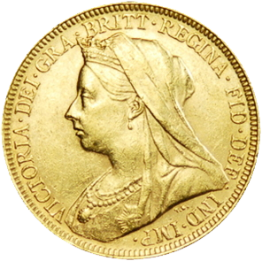
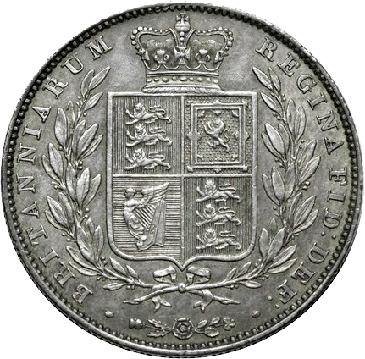
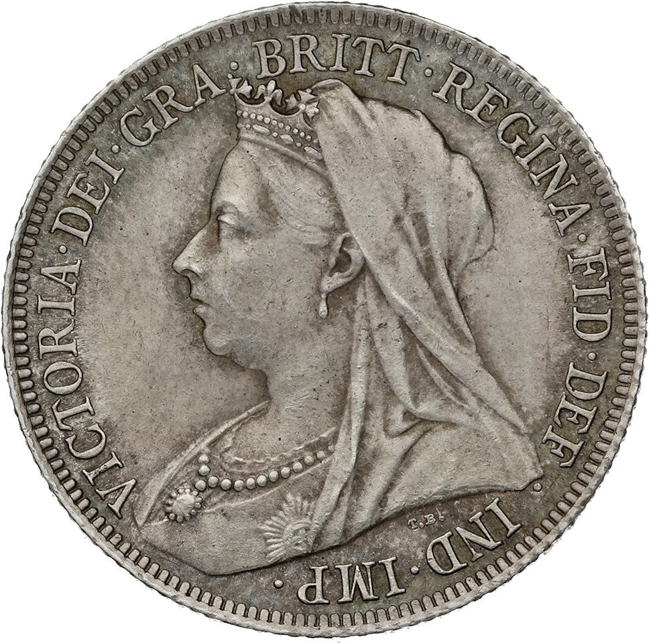
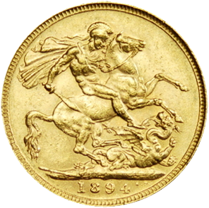
Activity 1: Money
Farthing | ¼ pence
Half Penny (ha’penny) | ½ pence
Penny | 1 pence
Threepence (thrupenny bit) | 3 pence
Sixpence | 6 pence
Shilling | 12 pence
Florin | 2 shillings
Half Crown | 2 shillings and sixpence
Crown | 5 shillings
Pound | 20 shillings

Slide 6
Activity 1 Resources
Coin Name | Pence | Shillings
Farthing
Half penny (ha’penny)
Penny
Threepence (thrupenny bit)
Sixpence
Shilling
Florin
Half Crown
Crown
Pound

Slide 7
Activity 1 Answers: All can …
Coin Name | Pence | Shillings
Farthing
Half penny (ha’penny)
Penny | 1
Threepence (thrupenny bit) | 3
Sixpence | 6
Shilling | 12 | 1
Florin |  | 2
Half Crown
Crown |  | 5
Pound |  | 20

Slide 8
Activity 1 Answers: Most can …
Coin Name | Pence | Shillings
Farthing | 1/4
Half penny (ha’penny) | 1/2
Penny | 1
Threepence (thrupenny bit) | 3
Sixpence | 6
Shilling | 12 | 1
Florin | 24 | 2
Half Crown | 30 | 2 ½
Crown | 60 | 5
Pound | 240 | 20

Slide 9
Activity 1 Answers: Some can …
Coin Name | Pence | Shillings
Farthing | 1/4
Half penny (ha’penny) | 1/2
Penny | 1
Threepence (thrupenny bit) | 3 | 1/4
Sixpence | 6 | 1/2
Shilling | 12 | 1
Florin | 24 | 2
Half Crown | 30 | 2 ½
Crown | 60 | 5
Pound | 240 | 20

Slide 10
Activity 1 Answers: Stretch & Challenge
Coin Name | Pence | Shillings
Farthing | 1/4 | 1/48
Half penny (ha’penny) | 1/2 | 1/24
Penny | 1 | 1/12
Threepence (thrupenny bit) | 3 | 1/4
Sixpence | 6 | 1/2
Shilling | 12 | 1
Florin | 24 | 2
Half Crown | 30 | 2 ½
Crown | 60 | 5
Pound | 240 | 20

Slide 11
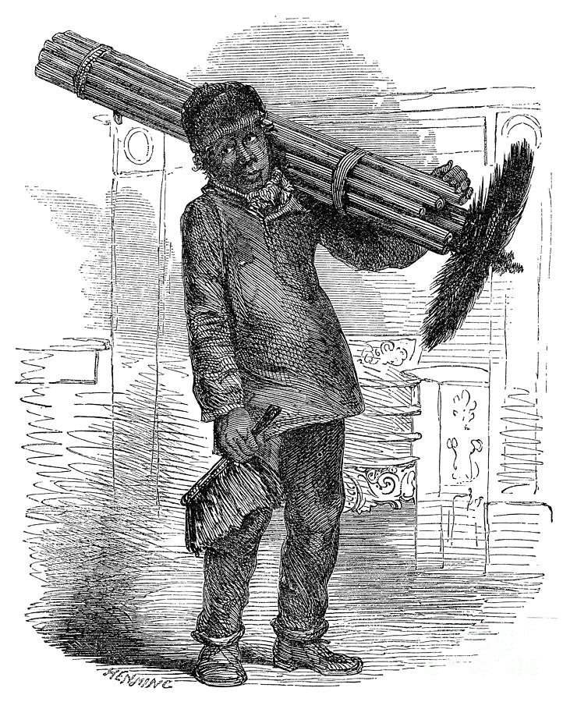
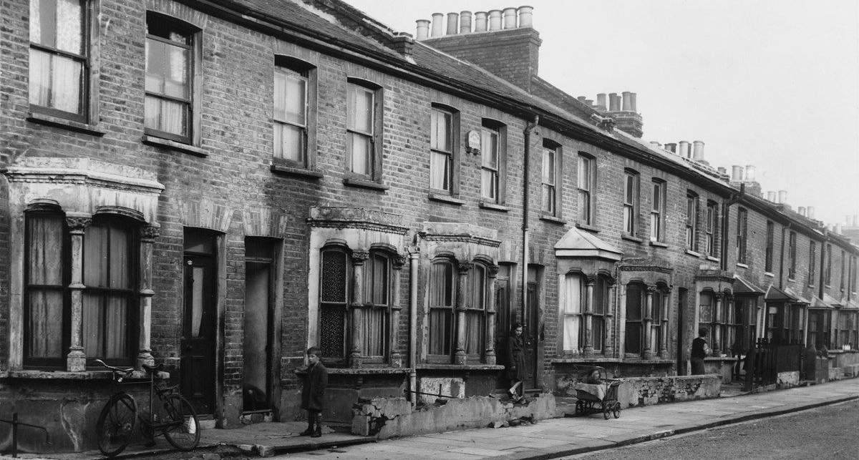
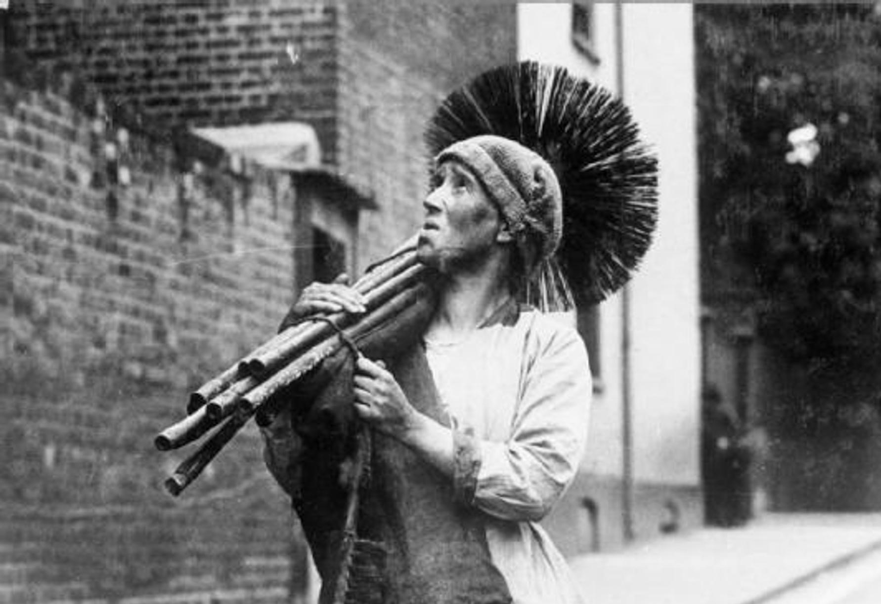
Activity 2: Creative Writing
Write a diary entry as Billy or Tosher, as you go from house to house
  What are you feeling?
  What happens to you?
  Who are the people you meet?

Slide 12
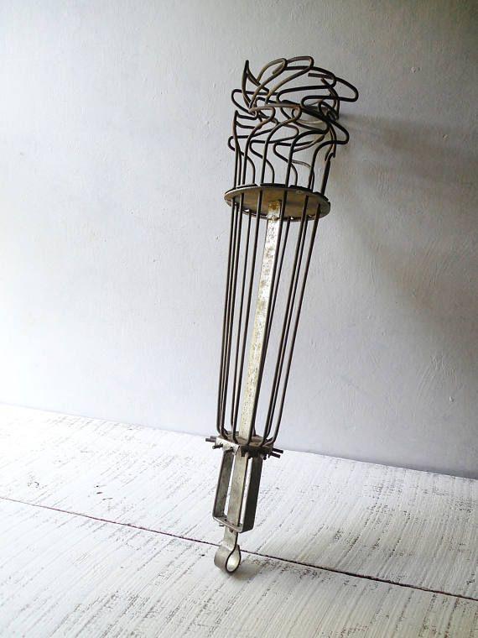
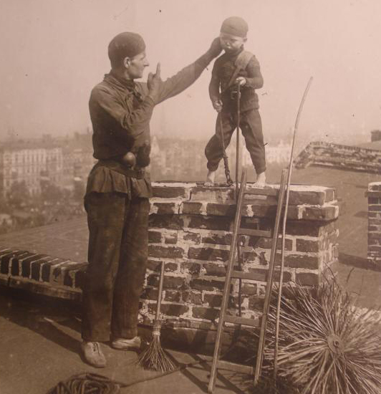
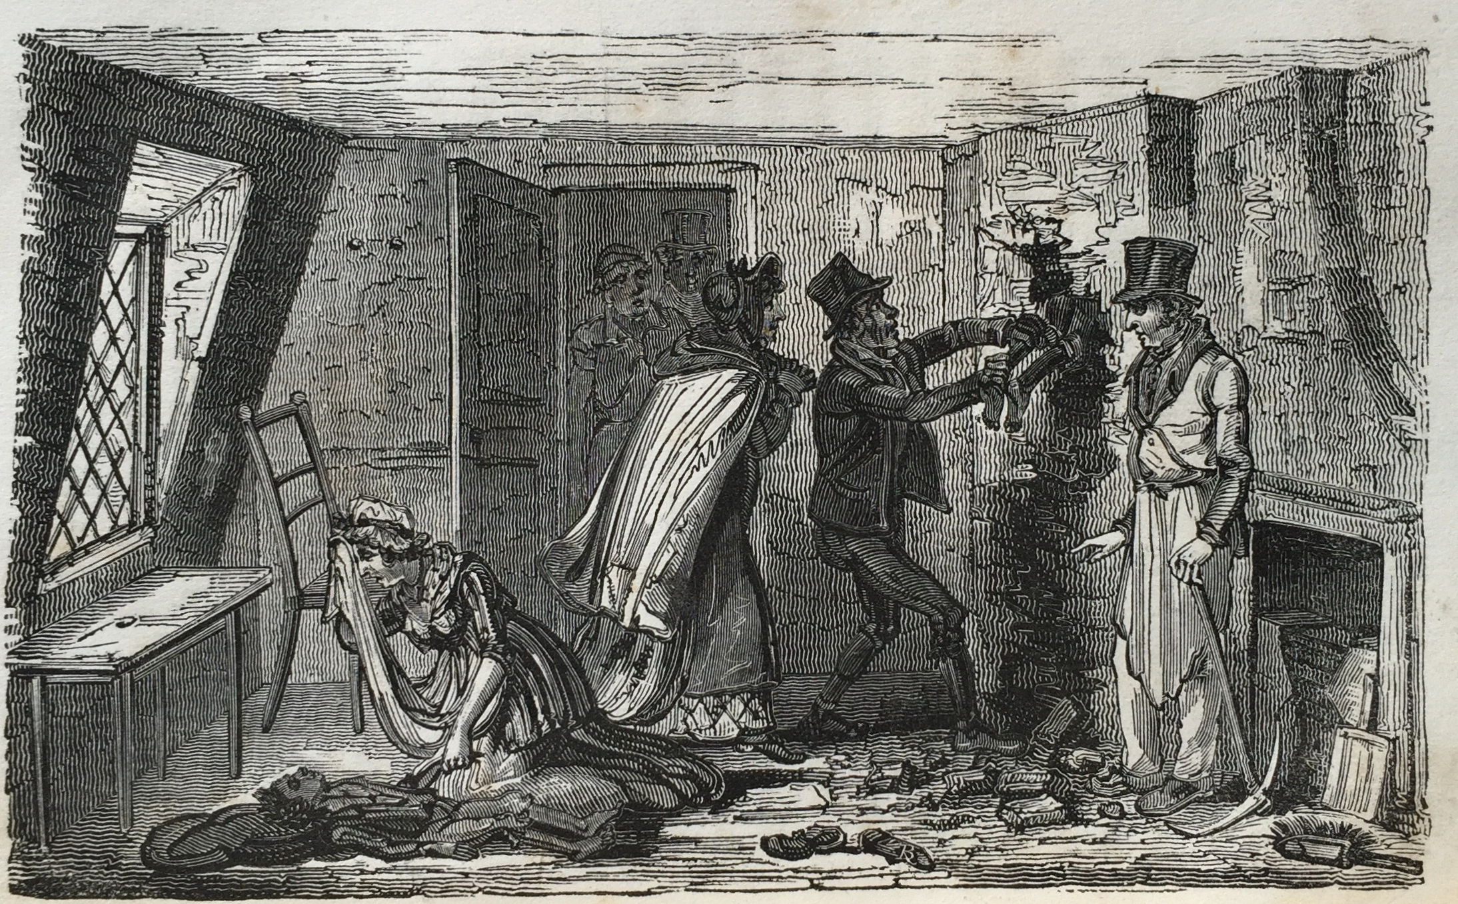
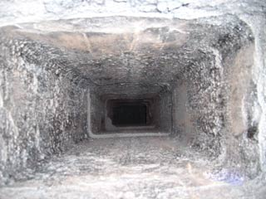
Activity 3: Formal Writing
Read the quotes on the resources slides, and look at the images on this slide. Imagine you are living in the Victorian era. Write a letter to your local MP, explaining the working conditions of climbing boys and persuading them to vote to ban their use.

Slide 13
Activity 3: Death of a Climbing Boy
Hall [the master sweep], Mrs. Bishop [the baker’s wife], and the landlord of the public house were in the shop when he went in. They told him a boy was in the flue; he asked the master how long; he said an hour; witness said, “My good God! why don’t you break down the flue and run down to the bakehouse?”
Got a poker, Hall followed him, and said he was too hasty: witness put his head up the chimney, and could hear the boy breathing hard; took the poker up stairs, and began to break open the flue; in a moment he had room to put his hand in, and cleared away the soot from his [Dowland’s] head; held it up, but seemed not to have life in it.
He went down stairs and broke the flue below, and got at his feet: when the master saw that, he said, “Let me get at him, and I will get him down, as he is only sulky, and is taking a nap.” Mr. Smith then came and made a greater aperture above, and he and witness lifted him out.

Slide 14
Activity 3: Testimony of Rodger Kaye
Rodger is 19 years old and works as a chimney sweep. He lives with his employer Thomson Black, a master chimney sweep, in Gallowgate Street in Glasgow.
He works beside Francis Hughes, another chimney sweep, and each of them has an apprentice. Rodger’s apprentice or climbing boy is Laurence McAllister. Hughes has a boy called John O’Neill, aged about 8 or 9, working for him.
Rodger saw Hughes and O’Neill between 8 & 9 o’clock on the morning of Thursday, 23 January 1840 when they left the house in search of work and he didn’t see them till about 5 o’clock when Hughes came back in a panic.
He says that he and Thomson Black arrived at the house where O’Neill was, but they didn’t know which vent O’Neill was in. They shouted but couldn’t get an answer. McManus, another apprentice, knew where he was and tried to climb down to him but it was too tight. He thought he heard O’Neill coughing.
They went to the bottom of the vent but the fireplace was blocked with stones left by the builders. They then broke a hole in the wall to make an opening.

